Slide 1
MARKETING CAMPAIGN ROI ANALYSIS
BY VISHNU JAISWAL

Slide 2
BUSINESS SCENARIO AND OBJECTIVE
IDENTIFICATION OF MOST SUCCESSFUL CAMPAIGN IN TERMS OF CONVERSIONS AND REVENUE GENERATION
FIND OUT HIGHEST ROI BY CAMPAIGN
ALLOCATION OF BUSINESS SPENDS

Slide 3
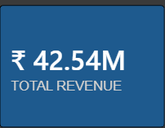
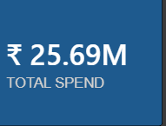
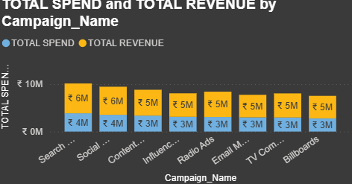
INSIGHTS AND BUSINESS FINDING
TOTAL REVENUE GENERATED IS APPROX 42M
Good to know that our spends on ads campaign was low but it can be more better after the recommendations
Social media and radios platforms drives out much of the revenue

Slide 4
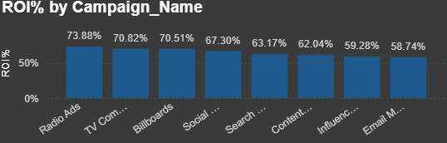
ROI GENERATORS CAMPAIGN
RADIO AND SOCIAL MEDIA ARE SHOWN TO BE THE MOST SUCCESSFUL CAMPAIGN AND THEY BOTH HAVE DRIVES OUT THE MUCH ROI
E-MAILS IS SHOWN TO BE THE LEAST PERFORMING PLATFORM

Slide 5
RECOMMENDATIONS
QUICK WINS
SHIFTS MORE SPEND BUDGET IN RADIOS AND TV THOUGH THEY HAVE MORE ROI AND WILL GIVE MORE IN FUTURE
DO AUDIT ON EMAILS AND INFULENCER MARKETING TO SEE OR OPTIMIZE THE BUDGET
LONG TERM STRATEGY
HIGH SCALE ROI CAMPAIGN SHOULD BE OUR CORE BUT WE HAVE TO TEST AND SCALE THE OTHERS FOR SOME MONTHS
DO ROI TRACKING AT EVERY QUARTER TO SEE THE FALL BEHIND CAMPAIGN

Slide 6
THANK YOU
END

